Slide 1
Library Management System

Slide 2
Contents
Introduction
Data flow Diagram
Technology Stack
Challenges and solutions
Demo
Future Scope
Conclusion

Slide 3
Introduction
The “Library Management System” was developed to address issues in the manual systems, aiming to streamline and enhance operations.
Designed to minimize errors during data entry, it is user-friendly and requires no formal training.
The system ensures secure, reliable, and fast management, allowing users to focus on other activities rather than record=keeping.
It helps manage information on books, students, librarians, and members, tailored to meet specific orhanization needs.
Features includes remote access, enabling efficient management from anywhere, anytime.

Slide 4
Data Flow Diagram
USER
REPORTS
LIBRARY MANAGEMENT SYSTEM
DATABASE

Slide 5
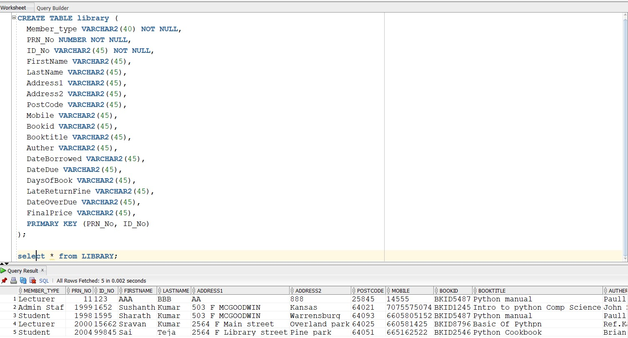
Data Structure and Tables
Registration:
This is a oracle database in which the administrator can manage the suer registration details.
User Details:
This is a Oracle Database in which the Administrator can manage the User details of Library Management System.

Slide 6
Technology Stack
Front End- Python, CSS, HTML.5.
Back End- Oracle MySQL Workbench, Python
Text Editors- VS Code Editor
Operating systems – Windows10 and Ubuntu linux

Slide 7
Challenges and Solutions
Common Issues:
Data consistency
User authentication
Performance Optimization
Solutions:
Secure login protocols
Efficient query handling
Regular backups

Slide 8
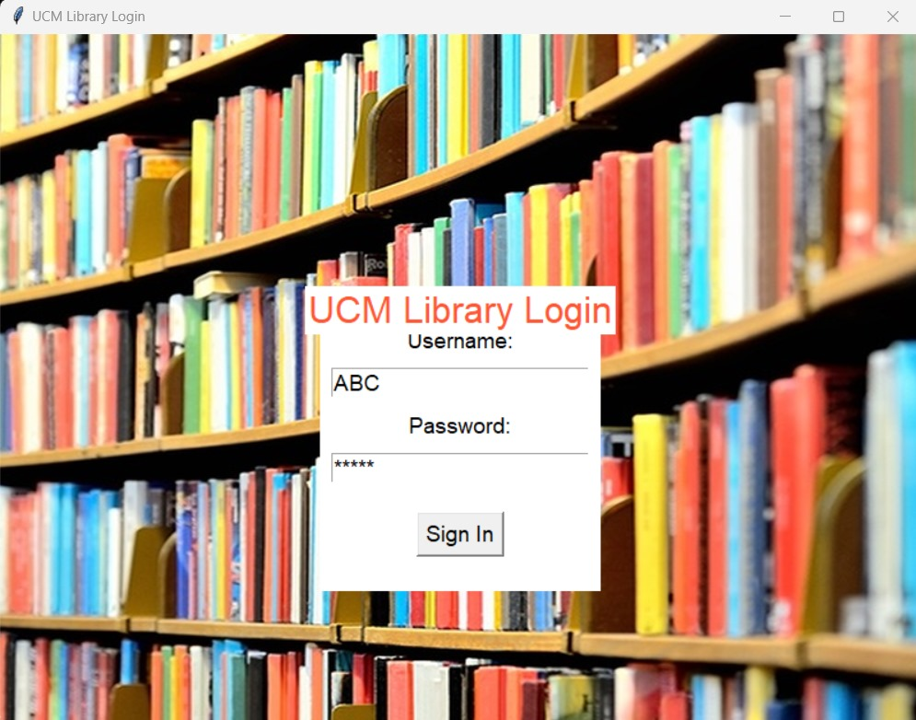
Demo
Admin:
This is the Library Management System Login Form. You have to enter Username and Password on it.

Slide 9
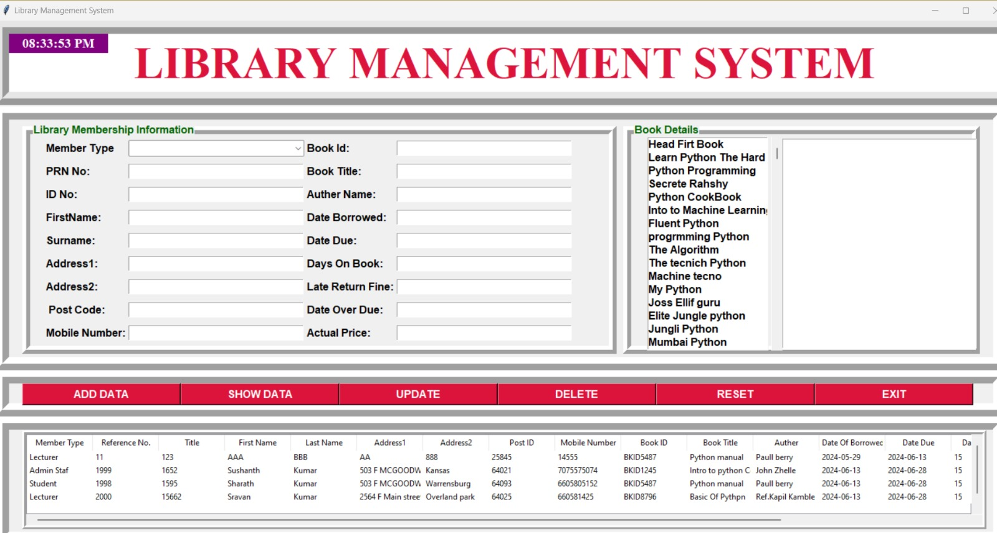
Demo
Home: This is the Main Window of the Library Management System. From here t he admin uses this system

Slide 10
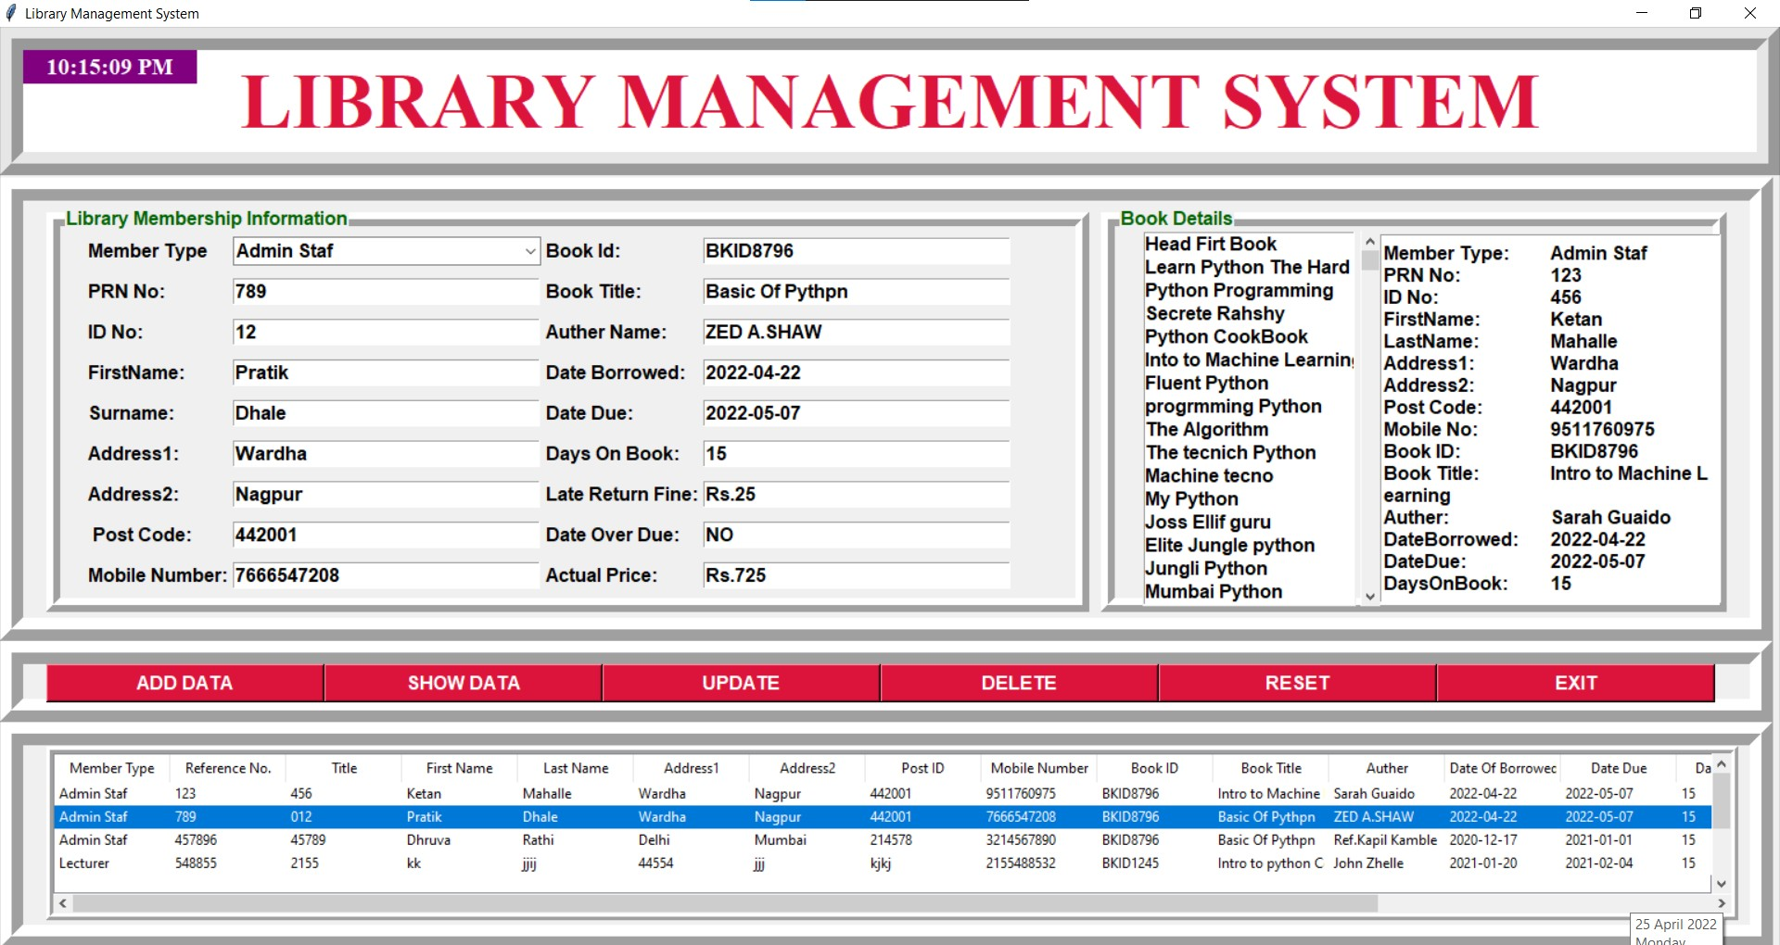
Demo
User Details:
This is the Library Management System User Details Form. This form shows the user details such First name, Last Name, Contact, Addresses and other details to the Administrator.

Slide 11
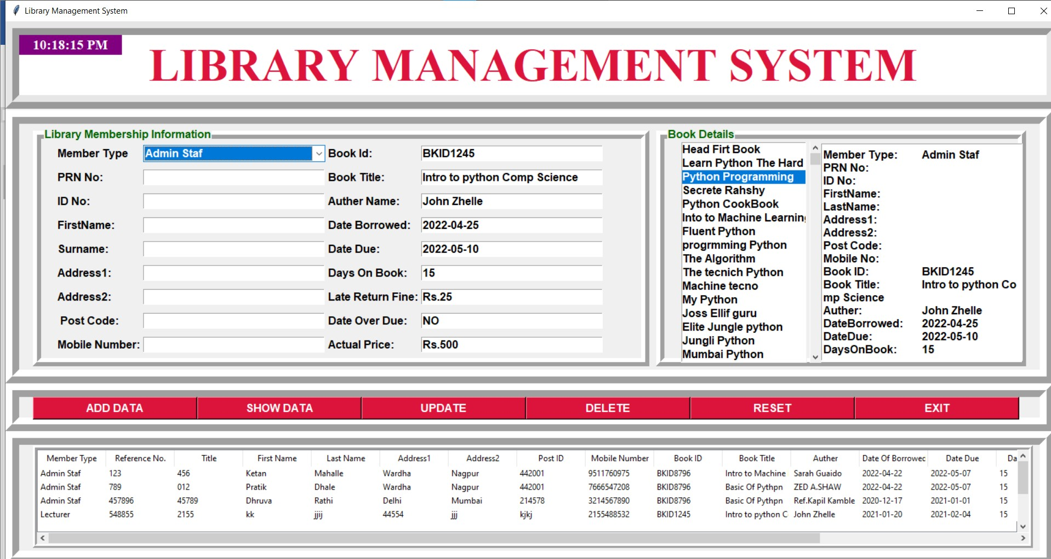
Demo
Book Details:
This is Library Management System Book Details Form. This form shows the details of the Books of the Library such as the Title of the Book, Author Name, Price of the Book and other details to the Administrator.

Slide 12
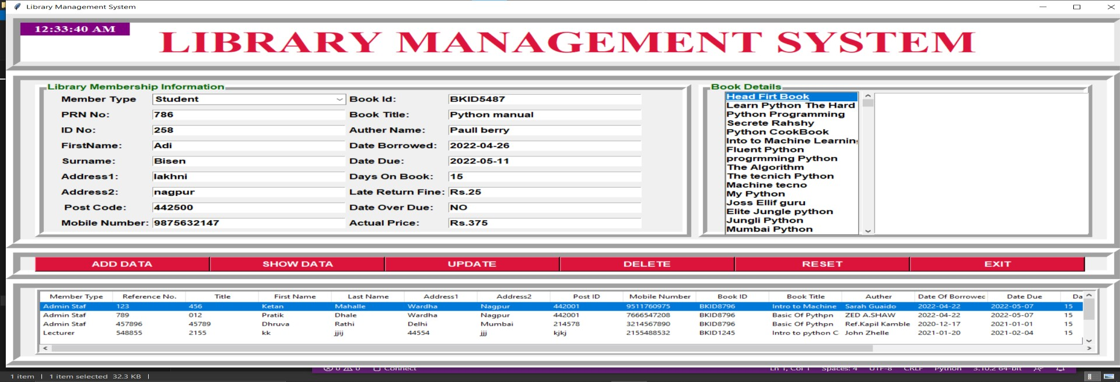
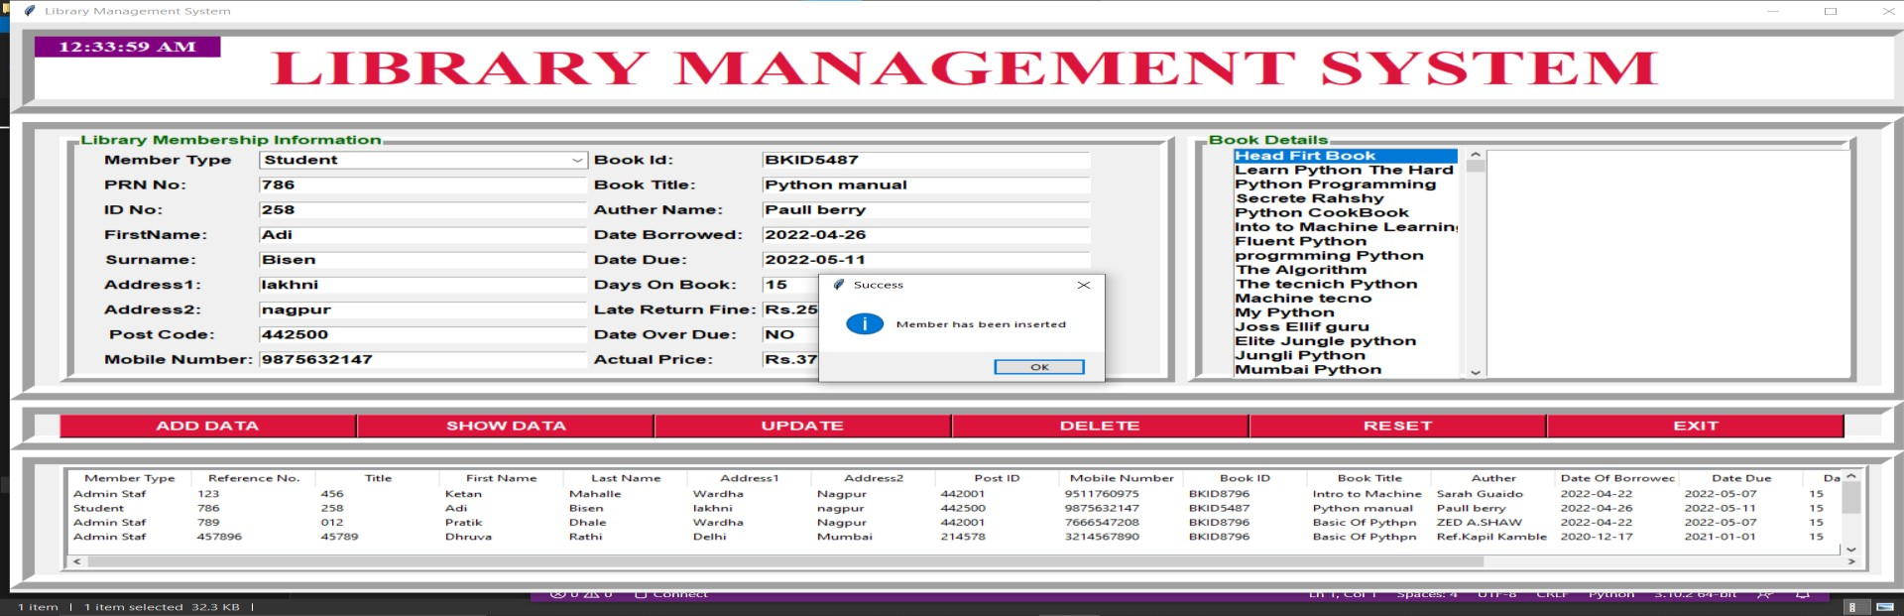
Demo(Add Data)

Slide 13
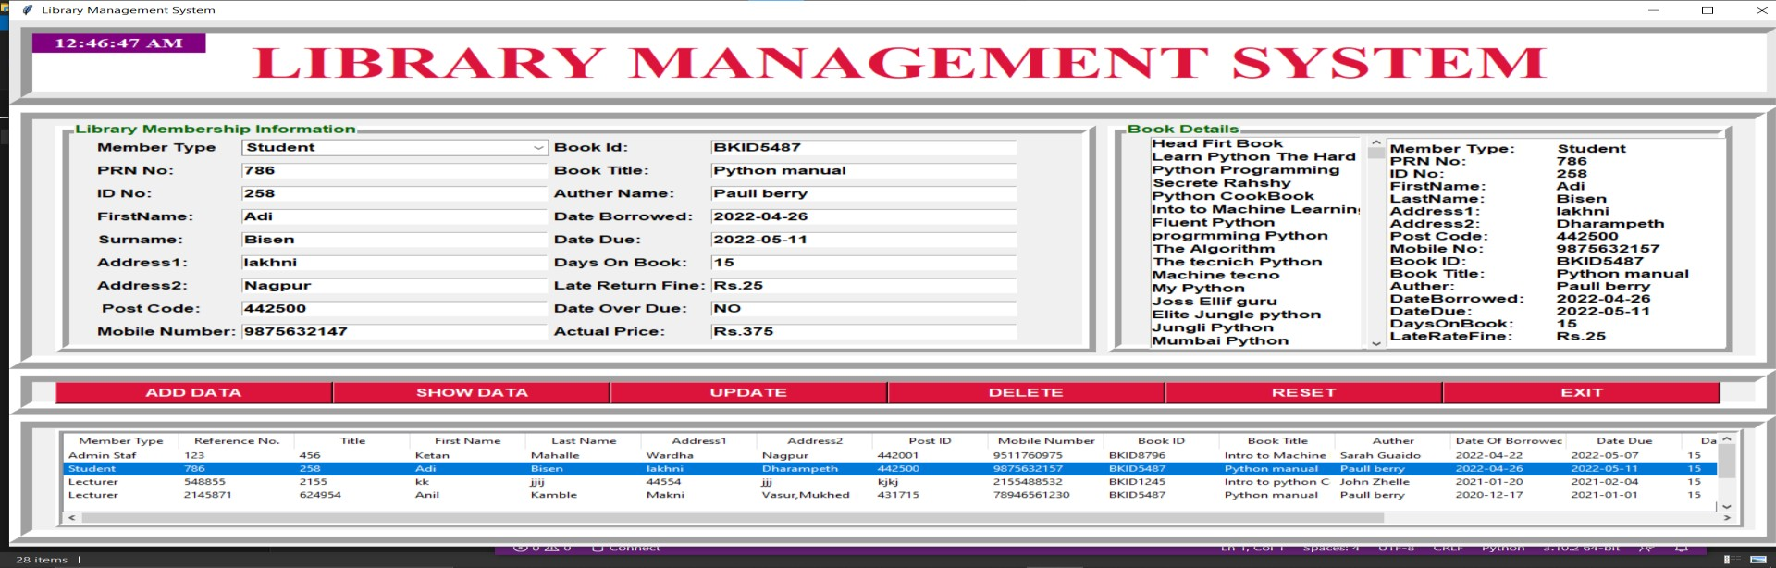
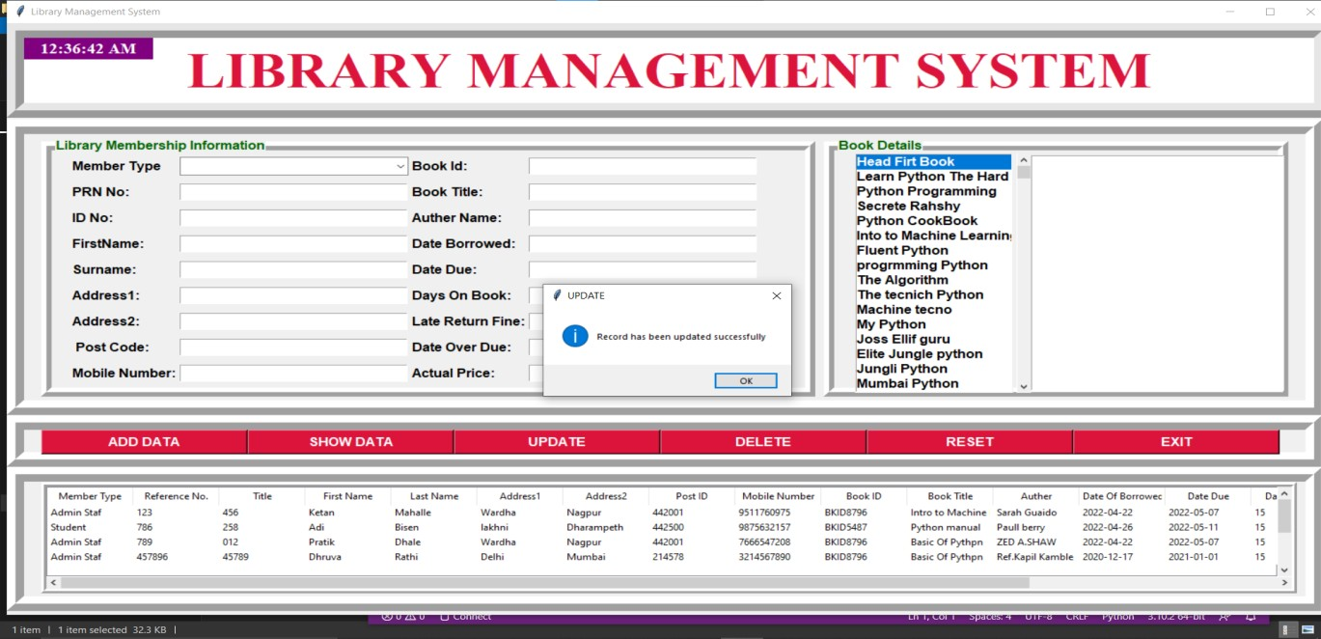
Demo(Update)

Slide 14
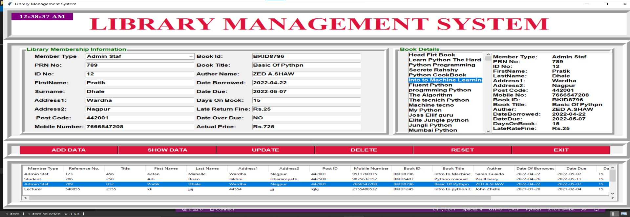
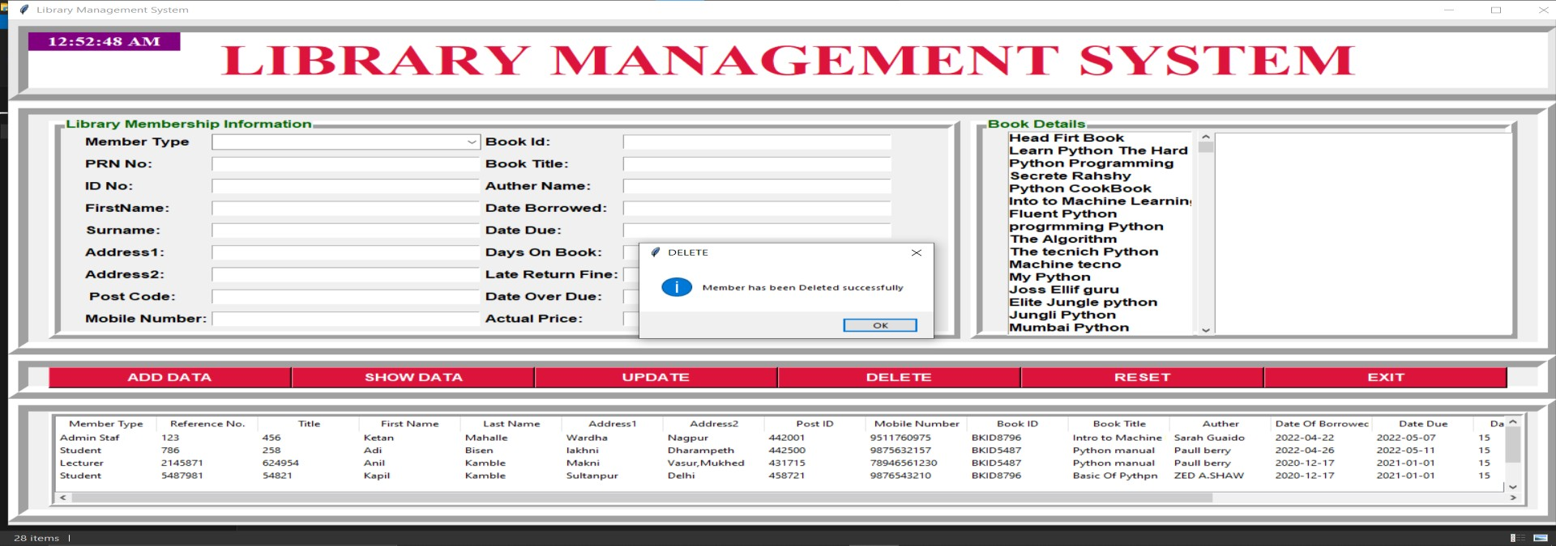
Demo(Delete)

Slide 15
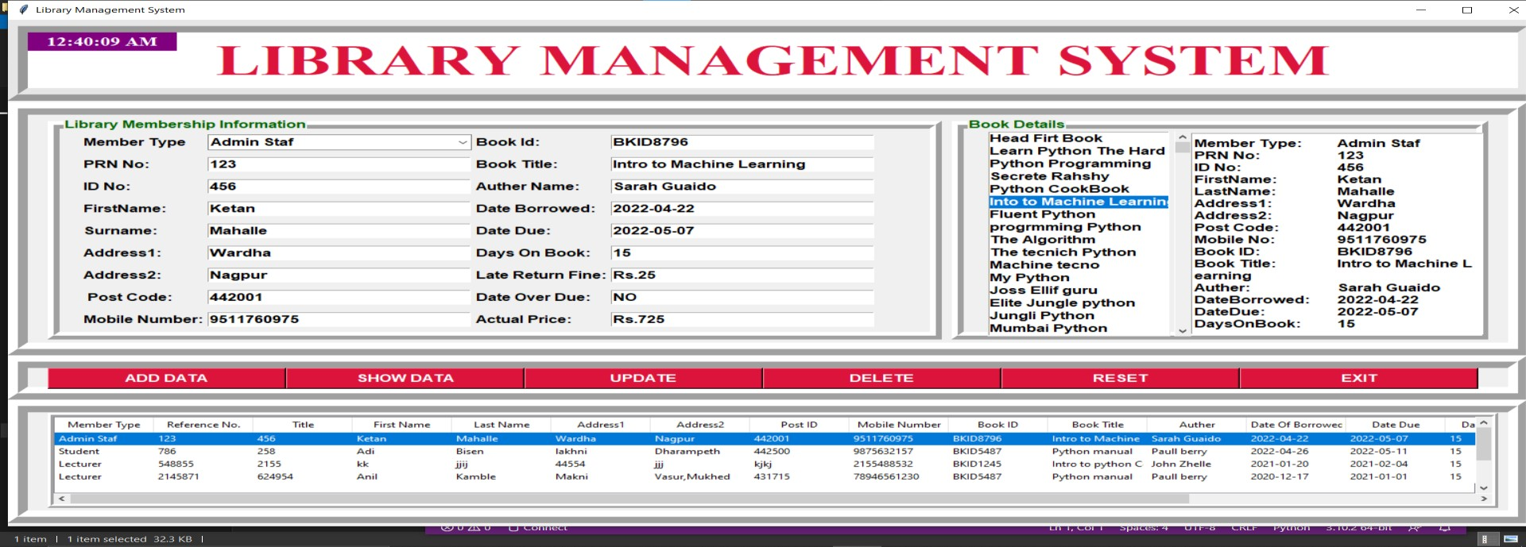
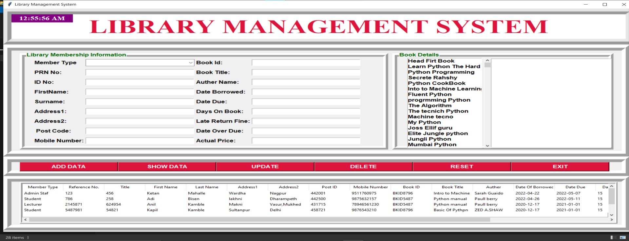
Demo(Reset)

Slide 16
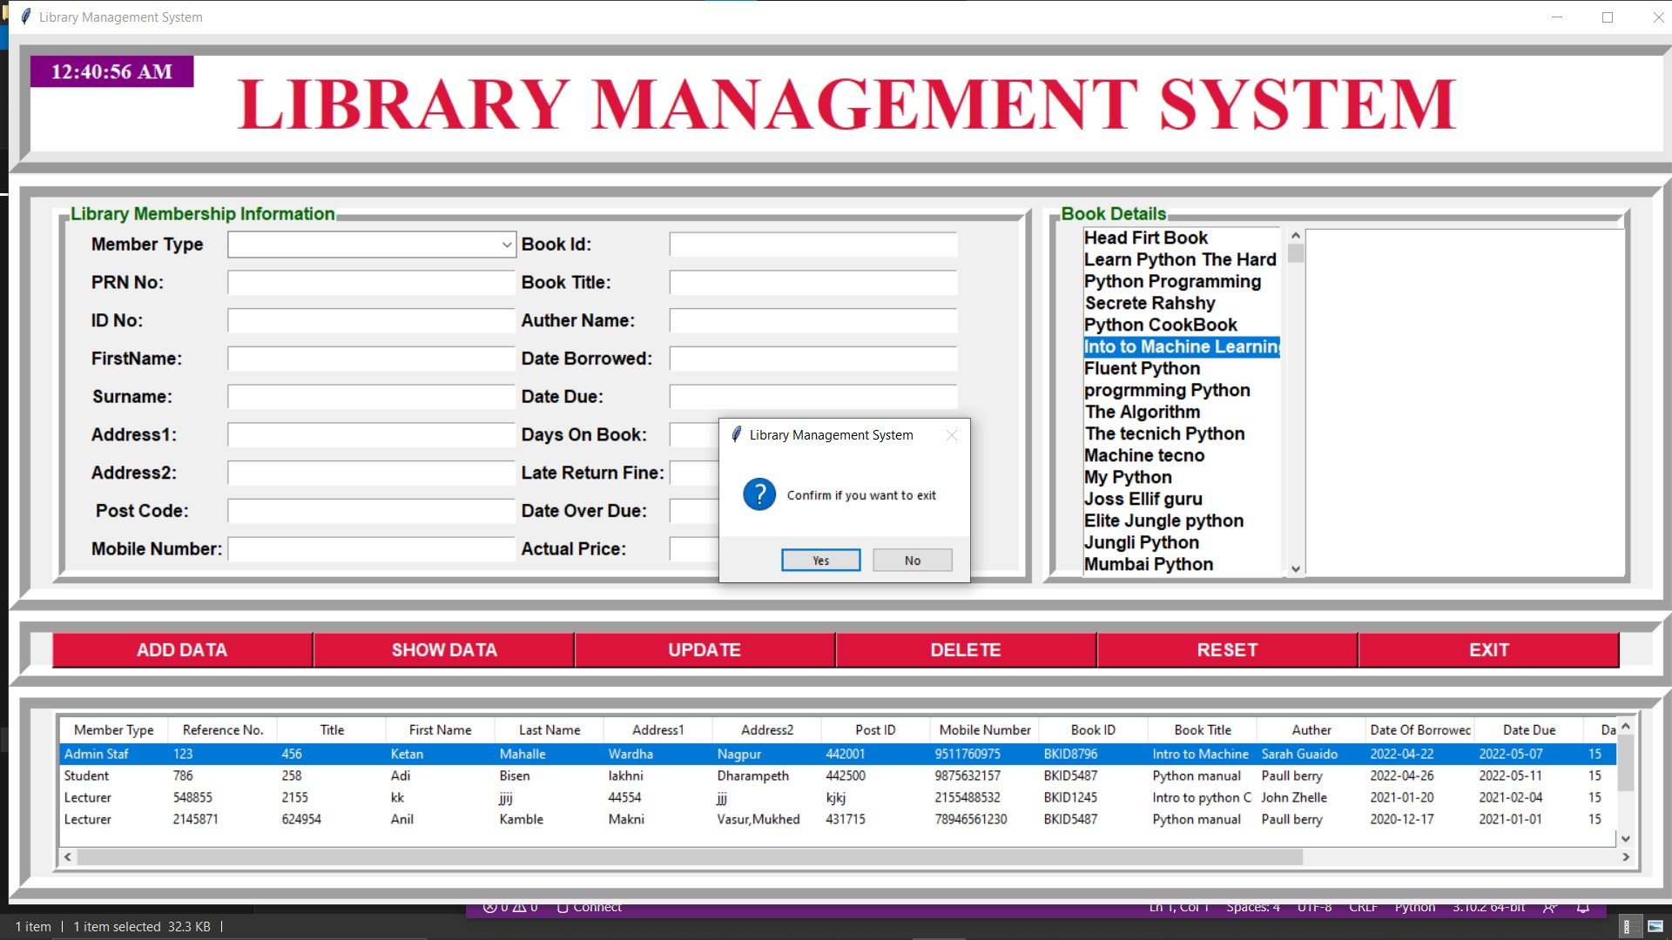
Demo(Exit)

Slide 17
Future Scope
“Library Management System”, currently provides complete information about users such as students, admins, and lecturers. Future updates will include additional content and features for these users.
Presently, the system manages books and user information. Future plans include adding online lectures, links, and more interactive content.
Enhancements will make the application engaging and user-friendly. Each user will have a login ID and password, allowing access from anywhere. Future updates will include major features like book reservations and more.

Slide 18
Conclusion
Library Management System allows the user to store the book details and the customer details. This software package allows storing the details of all the data related to library. The system is strong enough to withstand regressive yearly operations under conditions where the database is maintained and cleared over a certain time of span. The implementation of the system in the organization will considerably reduce data entry, time and also provide readily calculated reports.

Slide 19
Any Questions?

Slide 20
Thank you
Sharath Kumar Thungathurthi
Thriveni Avulamanda
Geya Geethika Chigurupati
Revanth Gangarapu

